Slide 1
Primo Customization 101

Slide 2
Who this class is for
Beginning primo admins who want to know more about customization and/or the primo customization framework
We will be speaking about the Central_Package folder structure, but we will be working on the individual view level.
This class is geared towards people who have basic knowledge of CSS, HTML and javascript (“pre-developers”)
The goal is to have a view when you leave today that you can deploy when you go home with little effort.

Slide 3
Goals of the Class
Starting and running commands for the Primo Dev environment
Editing HTML within a customization package
Editing CSS via Primo Studio and CSS Editors
Getting an introduction to the MVC (Model-View-Component) framework of AngularJS 1.6
Adding a footer on the services page as a component
Binding that component to Primo’s API output
Putting it all together for an interactive customization

Slide 4
GitHub Files
https://github.com/devday2019/ppt

Slide 5
Installing the Primo Dev Environment
Mac
https://github.com/ExLibrisGroup/primo-explore-devenv
Make sure you change the PROXY_SERVER value in gulp/config.js
Install the template package as your custom view, for ve, your viewID will be something like <institution_code>-<view_code>
rename the view folder with the same name as your viewID
Start a Terminal session
Change your command prompt location to the root of your primo-dev environment
Run the following commands: For Primo with Back Office: gulp run –view=<viewname> For Primo-VE: gulp run –view=<viewname> --ve

Slide 6
Installing the Primo Dev Environment
Windows
https://github.com/ExLibrisGroup/primo-explore-devenv PLEASE NOTE: YOU MUST USE NODEJS 6.x for the primo development environment!
Install the template package as your custom view
Make sure you change the PROXY_SERVER value in gulp/config.js
Rename the view package as the name of your viewID. For Primo VE, your viewID will be something like <institution_code>-<view_code>
Start the ‘NodeJS command prompt’, change directories to your dev environment, and then execute the following command:
For Primo with Back Office: gulp run –view=<viewname> For Primo-VE: gulp run –view=<viewname> --ve

Slide 7
Open Google Chrome or Mozilla Firefox
For primo with backoffice, your start URL should be: http://localhost:8003/primo-explore/search?vid_id=<<viewID>>
For primo-ve, your start URL should be http://localhost:8003/discovery/?vid=your-institution-code:your-view-code

Slide 8
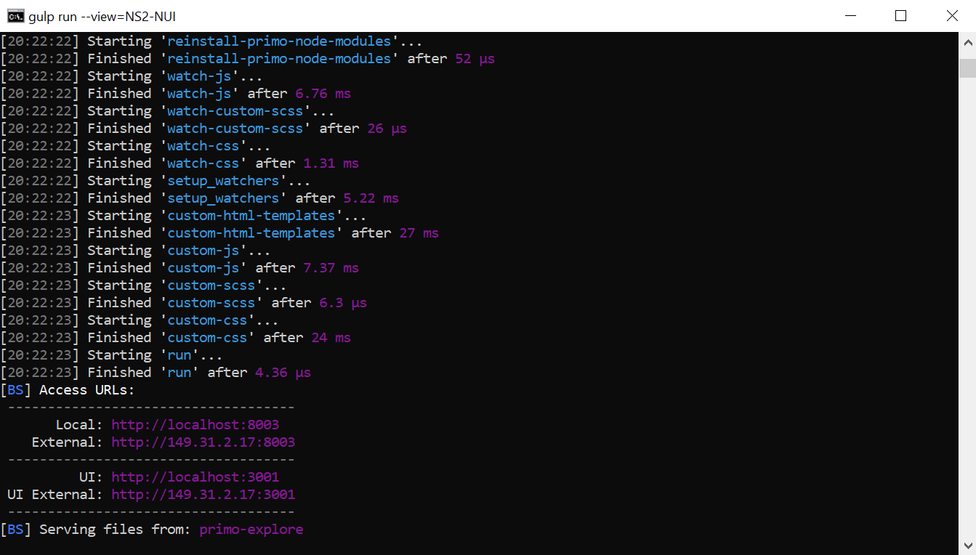
If it worked, you should see this in your nodejs console/Terminal…

Slide 9
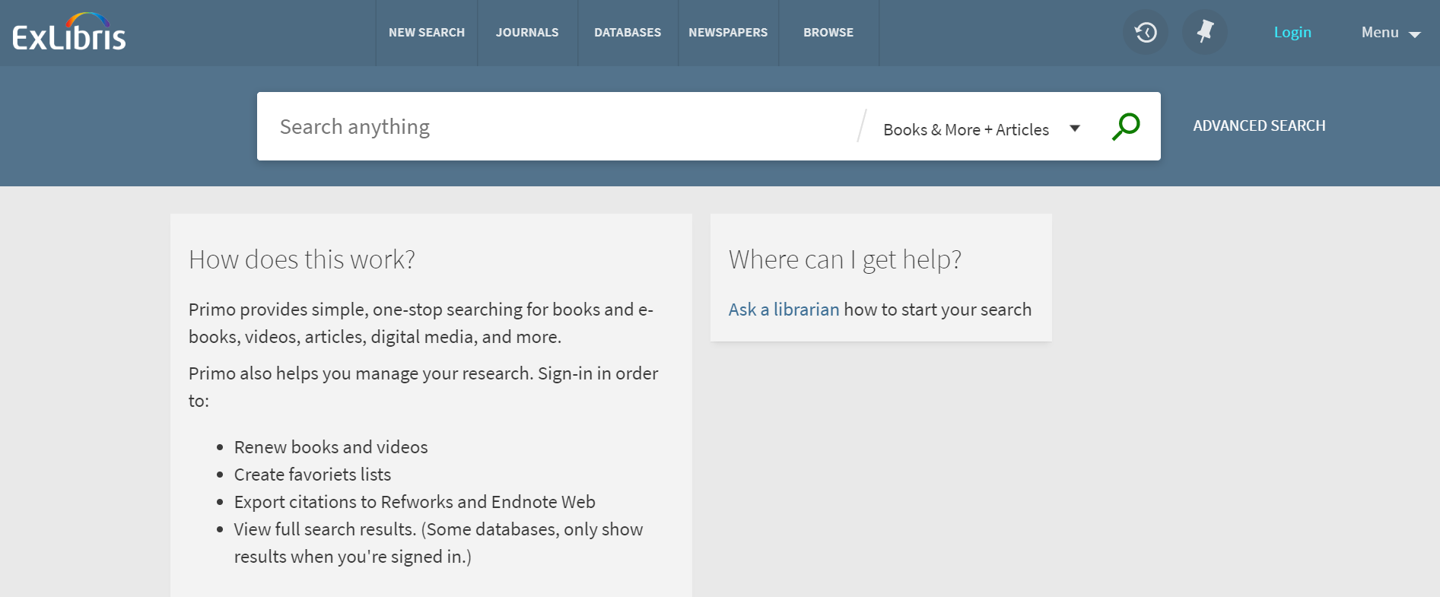
And this in your browser

Slide 10
A few things to note
Authentication Profiles should work, so if you are wanting to see ‘my account’ functions, etc., you can test logins and passwords
This is working against the data in your system, but the views are not available publicly until we deploy them. These views will only be available on your desktop, unless….
You wish to run the environment on one machine and have someone else connect using a different computer. If they put the URL in their browser, substituting your IP address for “localhost”, they should be able to interact with your primo view.

Slide 11
Custom Package Organization
CSS
HTML
homepage_fe_FR.html
Homepage_en_US.html
Images
library-logo.png
favicon.ico
icon_book.png
JS
Node_modules
Customization folder
CSS
JS
Note the different language codes

Slide 12
If you’re using a CENTRAL_PACKAGE
This is good for consortia or views where multiple staff are taking care of levels of care
The idea behind the central_package is inheritance, the central_package sets defaults and the individual views override styles, images and scripts in the Central_Package
You must designate whether your customization package is a Central_package or an individual view package.
If you are using a central package, there are different lines you must put into the custom.module.js file in order to activate scripts at both the CP level as well as the local view, see https://github.com/ExLibrisGroup/primo-explore-package/blob/master/README.md var app = angular.module('viewCustom', ['angularLoad']); var app = angular.module('centralCustom', ['angularLoad']);

Slide 13
Concatenation
When you run gulp run –view=<<viewID>> --ve, all of the files in the node_modules subdirectories are concatenated into single css and js files
CSS files are concatenated into custom1.css in the main CSS directory
Order is from top to bottom alphabetically (unless using browserify where you can specify import order)
JS files + custom.module.js are concatenated into custom.js file in the main JS directory

Slide 14
Now that we have our environments, let’s have some fun…
Global Color/Theme Changes
3 ways to accomplish this:
Do some of this work in primo-studio (http://primo-studio.exlibrisgroup.com)
Gulp app-css
Editing default stylesheets in the customization framework

Slide 15
Load custom icons, your logo, and favicon.ico files
Logo limitations
The file format of the image must be .png or .svg (SVG preferred)
The height of the image cannot exceed 100 pixels.
The width of the image cannot exceed 300 pixels.
The size of the image cannot exceed 30 KB.

Slide 16
Primo Studio
http://primo-studio.exlibrisgroup.com
Advantages: you can add customizations that are in primo studio very easily Themes are very easy, as are loading of custom images, logos and icons
Disadvantages: the majority of customizations are not in primo-studio yet, so you will eventually require some level of customization How are you ever going to code and learn your own customizations?

Slide 17
Exercise 2: Primo Studio (10 minutes)
Visit http://primo-studio.exlibrisgroup.com
Configure primo studio to work with your environment
Choose colors, then update theme (note these values somewhere, we will use them in the next exercise)
Take images from https://github.com/devday2019/custom_icons and use them to ‘customize’ your view.
Add them to your view and then preview your view.

Slide 18
Color Pallette
Pallette Customization of Primo is built from the Material Design Framework
Primo’s instance of material design assumes the following:
A primary tone
A secondary tone (complement or accent)
A background
Link color
Warning
Positive Color
Negative color
Notice color
Text is source sans pro or Helvetica neue or Helvetica, then Sans-serif
Color names as well as hex values are acceptable (“tomato” instead of the hex value of #ff6347, etc) (see https://www.w3schools.com/colors/colors_names.asp for reference)

Slide 19
App-css and other resources
For accessibility checking, please see the following resources: Color, Material Design and Accessibility: https://material.io/tools/color/#!/?view.left=0&view.right=0
Be aware of which components have light text and which components have dark text. Override those components when there are problem areas to substitute dark text. I tend to put local CSS styles in their own module/stylesheet so that local styles are easy to read. Keep module specific styles with modules. Keep organization-specific styles in their own sheet.

Slide 20
App-css
There are gulp tasks that allow you to create the same CSS files as Primo Studio.
Create a colors.json file {
"primary": "tomato",
"secondary" : "#FF0000",
"backgroundColor" : "white",
"links": "#5C92BD",
"warning": "salmon",
"positive": "#0f7d00",
"negative": "gray",
"notice": "#e08303"
}

Slide 21
App-css
There are gulp tasks that allow you to create the same CSS files as Primo Studio.
From the root of your primo-dev environment, run gulp app-css –view <<viewID>>. This will create the necessary CSS files for your view using the customized values

Slide 22
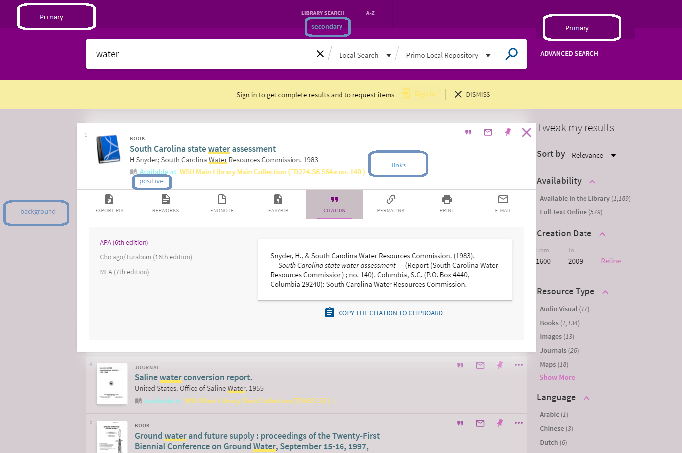
These material design color attributes are implemented below:

Slide 23
CSS Selectors
There are a number of ways to assign CSS styles to a particular component
PRM directive – primo has its own primo directives, this can be useful when you want to address a large block of content: prm-search-bar
Class – if there is a specific class that you wish to address, you can add the attribute within a custom style .class {color:#FF0000;}
ID – styles can also be applied to IDs. This is useful if you are attempting to define a class o a specific ‘block’ #tags {display:none}

Slide 24
CSS Selectors
These three methods can also be used together to get very precise over how something is to be applied: prm-search-result-list-after > div {flow-direction:column-reverse}

Slide 25
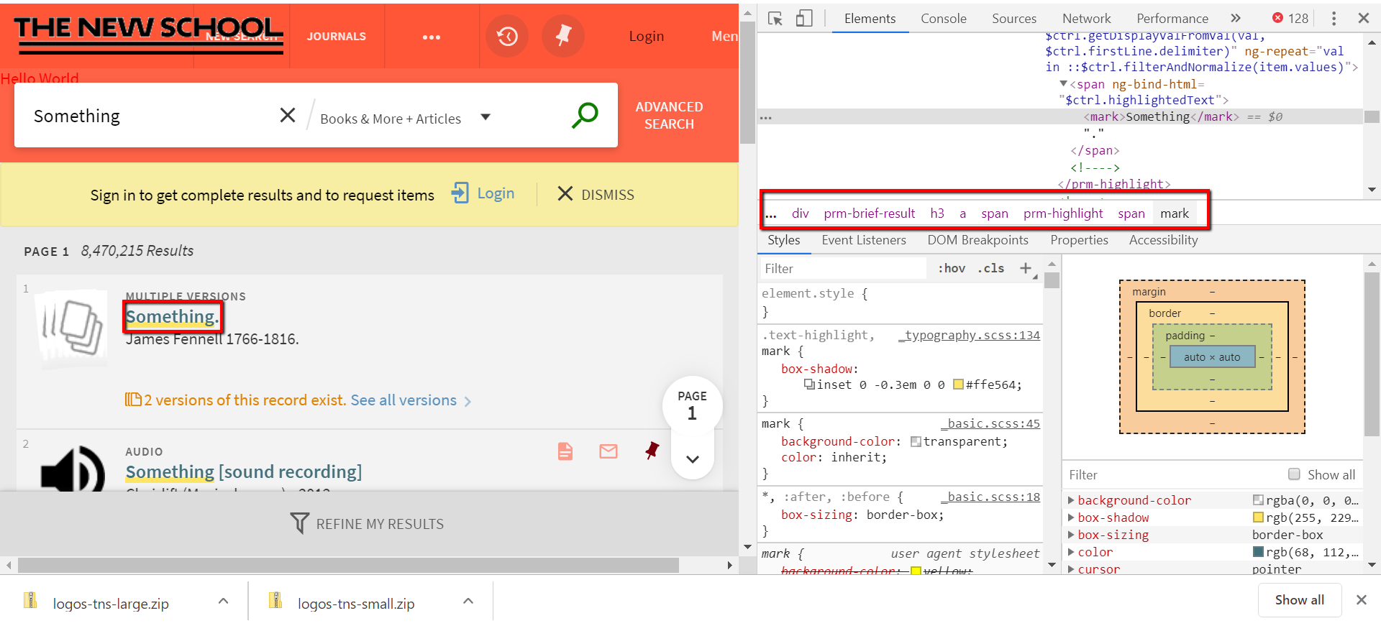
CSS Selectors using Google’s Developer Console

Slide 26
Html editing – material design directives
Editing HTML is the same as editing other HTML tags, except for the presence of material design directives (md-card, etc.). Follow the design of these cards when creating blocks of content for your homepage or other HTML pages..

Slide 27
Exercise 3: Editing HTML, CSS and icons (15 minutes)
Put together a basic template of your view, using university/corporate colors, icons and editing the HTML for your homepage.
We will start with global changes and work our way through more granular changes as the workshop goes on.
Keep accessibility in mind. Use the accessibility checker from slide 18 to inform your color/theme choices.

Slide 28
Questions?

Slide 29
Break

Slide 30
Getting your view package ready for customization
ng-model
A few definitions:
Template – a set of HTML tags that should be “injected” with each occurrence of a particular tag
Controller – a set of instructions in Javascript that control the flow and presentation of data within a template
Component – a set of a template + a controller to create a reusable interface component
Directive - markers that tell AngularJS to attach a certain behavior to a DOM component (ng-bind, ng-model, ng-if, ng-repeat, examples: https://www.w3schools.com/angular/angular_directives.asp)
Normalization – the conversion of dashed names to camelCase from HTML component to Javascript
Model – data stored by the application. Data can originate from user interaction or it can be connected via ‘bindings’. Oneway bindings are read-only, two-way bindings allow users to input and change data through form-fields and component interaction.
View- the HTML tag where templates should be substituted

Slide 31
Creating AngularJS customizations for Primo
In order to get your customizations to work within the primo dev environment, you’ll need to include them in a functional wrapper. This is a file, called custom.module.js, in the top-level ‘js’ directory with the following contents: var app = angular.module('viewCustom',['angularLoad']);
We need to create a directory, called ‘node_modules’, at the base of our views. Within that directory, let’s create a directory called ‘primo-explore-hello-world’, and then subdirectories called ‘js’ and ‘css’

Slide 32
Hello World Code explained
Download the code from GItHub: https://github.com/devday2019/primo-explore-hello-world
app.component('prmLogoAfter', {
bindings: {},
template: '<div class="hello-world"><span>Hello World</span></div>'
});

Slide 33
Our first customization – hello world (10 minutes)
Take the code that you downloaded from GitHub and change the primo-explore directive that Hello World is being injected into. Using CSS, create a css folder, then a helloworld.css file and style the link green and bold.
Reload the css and js, start the primo dev environment again and see your changes.

Slide 34
Templates – Adding A Custom Footer
app.component('prmExploreFooterAfter', {
bindings: { parentCtrl: '<' },
template: '<strong>This is my custom footer. Brought to you by The New School Libraries.</strong>'
});

Slide 35
Breaking down this customization
app.component('prmExploreFooterAfter', {
bindings: { parentCtrl: '<' },
template: '<strong>This is my custom footer. Brought to you by me.</strong>'
});

Slide 36
Second Customization – getting variables from Primo
app.controller('prmNoSearchResultsAfterController', [function () {
var vm = this;
vm.getSearchTerm = getSearchTerm;
function getSearchTerm() {
return vm.parentCtrl.term;
}
}]);
app.component('prmNoSearchResultAfter', {
bindings: {parentCtrl: '<'},
controller: 'prmNoSearchResultsAfterController',
template: '<strong>My name is <i>{{$ctrl.getSearchTerm()}}</i>. You Killed my father, prepare to die.'
});

Slide 37
Add CSS Styles to suppress the OTB card
Add CSS: /* Hide out-of-the-box no search results card */ prm-no-search-result > md-card.default-card {
display: none;
}

Slide 38
Restart the service and load the new styles

Slide 39
Components
Because of the nested nature of HTML tags, these elements have parents and children. In the example, there are 3 children to the single <ul> parent tag.: <ul>
<li>test</li> <li>two</li>
<li>Three</li>
</ul>

Slide 40
Components
Controllers can also be bound by children components bindings:{Parentctrl: ‘<‘}

Slide 41
What does this look like?
Primo API Output
parentCtrl
$ctrl.getSearchTerm
Directives: ng-if, ng-show, ng-hide (if something is not true, show something, if not true, don’t show)
prmNoSearchResultsAfterController
References and functions
VM
Data Models (Scopes)
Controllers
Views

Slide 42
Download code
https://github.com/devday2019/primo-explore-custom-zero-search-results

Slide 43
Let’s walk through this javascript
app.controller('prmNoSearchResultsAfterController', [function () {
var vm = this;
vm.getSearchTerm = getSearchTerm;
function getSearchTerm() {
return vm.parentCtrl.term;
}
}]);
app.component('prmNoSearchResultAfter', {
bindings: {parentCtrl: '<'},
controller: 'prmNoSearchResultsAfterController',
template: '<strong>This is my custom no results areas. The term you searched for was <i>{{$ctrl.getSearchTerm()}}</i>. Brought to you by The New School Libraries.</strong>'
});
NOW. We have data from a component being processed by a controller and returned back to the view

Slide 44
Examining components, their controllers and their data
Open the Developer Console
Perform a search of gibberish
Type the following into the developer console e=angular.element(document.querySelector(‘prm-no-search-result-after’)) c=e.controller(‘prm-no-search-result-after’)

Slide 45
Now we have data from a session going to a view from a controller

Slide 46
Activity 4: Take 10 minutes to see if you can get this to work.
Hide the out of the box messaging
Add your own custom message for 0 search results
Add a search link to worldcat with the search term in it (hint: the worldcat URL is http://www.worldcat.org/search?qt=worldcat_org_all&q= plus the query term concatenated.

Slide 47
Questions?

Slide 48
Getting Info From PNX
The first thing you have to do is find where the data is stored that you want to use
You can run commands in the developer console to begin to get an idea of what data is connected to your components and their controllers
So if we perform a search, we can click into the full view of an item and see what data is bound to the parent controller. Open the Developer Console in Google Chrome or the Web Console in Firefox to select components and see their properties. e=angular.element(document.querySelector(‘prm-full-view’) c=e.controller(‘prm-full-view’)
we can do this for any component where we want to build a customization

Slide 49
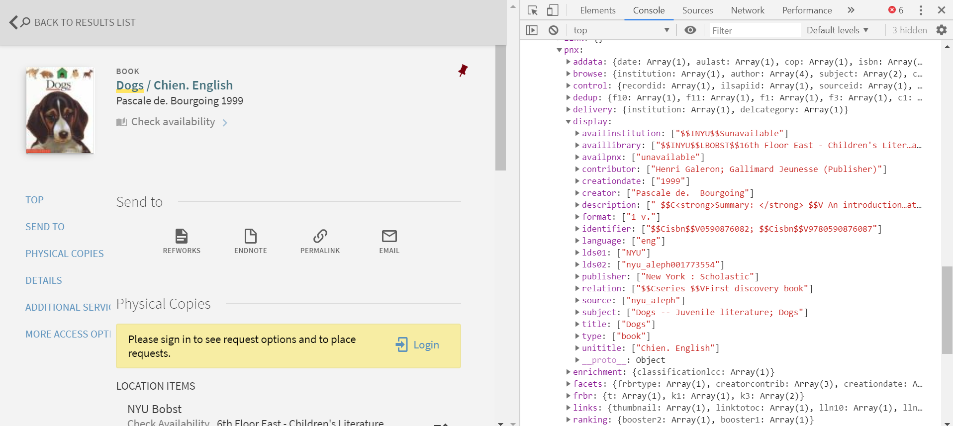

Slide 50
In this particular customization, we will:
Grab the recordID from the Primo API response
Print the recordID underneath the thumbnail

Slide 51
First: Create the folder for the customization
Create the folder called ‘primo-explore-thumbnail-info’ and the subdirectories of ‘js’ and ‘css’
Find the directive we want to print the record ID
‘prm-search-result-thumbnail-container-after’
Then see what data it has associated with its controller using developer console

Slide 52
app.controller('prmSearchResultThumbnailContainerAfterController', [function () {
var vm = this;
vm.getSearchTerm = getSearchTerm;
function getSearchTerm() {
return vm.parentCtrl.item.pnx.control.recordid[0];
}
}]);
app.component('prmSearchResultThumbnailContainerAfter', {
bindings: {parentCtrl: '<'},
controller: 'prmSearchResultThumbnailContainerAfterController',
template: ‘<a href=\’\’><strong>recordID: {{$ctrl.getSearchTerm()}}</strong></a>'
});

Slide 53
Questions? Break.
How might you create a link to execute another search with the recordID?
Function
String in template

Slide 54
Importing content from the internet into your interface
Up to this point, components have gotten data from Primo and we have bound components to content that Primo has internally bound to the system.
AngularJS has a number of services which can push, or pull, data from other sources/destinations. One of the most powerful services to use is called $http.

Slide 55
WPSnippet
Download the code for this from github:
http://www.github.com/devday2019/primo-explore-wpsnippet

Slide 56
Break / Questions

Slide 57
Finalizing your customization package
When you are done with your view package and you are ready to upload, you must create a zip file of the package using another gulp task, gulp create-package
Once run, you will be asked which view you would like to package and then follow the prompts.
The zip files is stored in a folder called packages. These files can be uploaded to your primo instance and deployed.

Slide 58
Finalizing a Primo Studio addon
With Primo Studio, you can only build one function at a time.
Use the gulp prepare-addon task and answer all of the questions related to the project.
Make sure you have your github repository link for your function (should be named primo-explore-something)
That you upload the project to NPM for easy installation and upgrading
That you keep up to date with contributions the community may be adding to your project.

Slide 59
Thank you

